Slide 1
Vaibhav Sharma, Taejoon Byun, Se Eun Oh and Elaheh Ghassabani Final project of CSCI5271: Introduction to Security December 7,2015
Link prefetching:
A Website Fingerprinting Defense for Tor

Slide 2
Outline
Anonymity network
Website fingerprinting attack
Related works
Link prefetching
Experiments
Conclusion
Future works

Slide 3
Anonymity Network
Anonymity use case
Normal people
Circumvent censorship
Skirt surveillance
Protect privacy from identity theft (ISP, websites …)
Citizen journalists (in repressive nations)
Activist and whistleblowers
Military
Intelligence gathering
(geographically) Hidden services
https://www.torproject.org/about/torusers.html.en

Slide 4
Anonymity Network
How Tor works
Tor node
Unencrypted
Encrypted
Alice
1. Alice's Tor client obtains a list of Tor nodes from a directory server.
Charlie
Bob
https://www.torproject.org/about/overview.html.en#thesolution

Slide 5
Anonymity Network
How Tor works
Tor node
Unencrypted
Encrypted
Alice
2. Alice's Tor client picks a random path to destination server.
Charlie
Bob
https://www.torproject.org/about/overview.html.en#thesolution

Slide 6
Anonymity Network
How Tor works
Tor node
Unencrypted
Encrypted
Alice
3. If at a later time, the user visits another site, Alice's Tor client selects a second random path.
Charlie
Bob
https://www.torproject.org/about/overview.html.en#thesolution

Slide 7
Website Fingerprinting
What is website fingerprinting?
Even when the payload is encrypted and anonymized, certain features cannot be hidden such as
Source and destination of the packets
Number of packets, timing and size
These features form a unique “fingerprint” of a website.
Amazon.com
Youtube.com
Facebook.com

Slide 8
Website Fingerprinting
Attack Model
The adversary targets a specific victim and tries to identify which website the victim visits.
Attacker trains a classifier under conditions similar to those of victim.
The adversary may have enough background knowledge about the user to reproduce his configuration.
Alice
Juarez, M. et al.: A Critical Evaluation of Website Fingerprinting Attacks. (2014).

Slide 9
Idea
A simple and easy way to confuse eavesdropper ?
The accuracy of website fingerprinting attack depends on the predictability of website fingerprints.
The attack assumes that the fingerprint of a visit to a website will be similar to the previous visits.
What if it is not so?
What if a fingerprint looks different for each visit?
Could randomized link prefetching provide extra defense against website fingerprinting attacks?

Slide 10

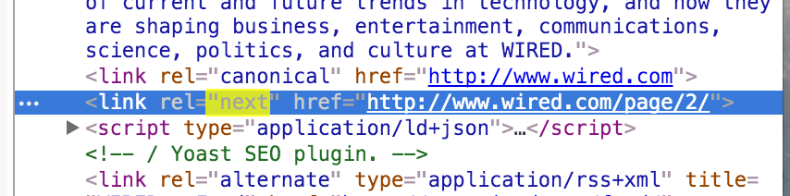
Link Prefetching
What is link prefetching
Link prefetching is a syntax to give web browsers a hint about documents that it should pre-fetch because the user might visit them in the near future.
A web page provides a set of prefetching hints to the browser, and after the browser is finished loading the page, and after an idle time has passed, it begins silently prefetching specified documents, storing them in its cache.
https://en.wikipedia.org/wiki/Link_prefetching

Slide 11
Link Prefetching
How many websites use prefetching?
Analyzed about 6,000 Alexa Top websites.
About 60 websites use at least one of pre-fetch features – {‘dns-prefetch’, ‘prefetch’, ‘next’, ‘prerender’}
Some of the website…
prefetching_websites.csv
01: http://minneapolis.craigslist.org
02: http://www.pornhub.com/
03: http://xhamster.com
04: http://www.redtube.com/
05: http://www.youporn.com/
06: http://www.smzdm.com/
07: http://slickdeals.net
08: https://chaturbate.com/
09: http://www.tube8.com/
10: http://allrecipes.com
11: http://www.teepr.com/

Slide 12
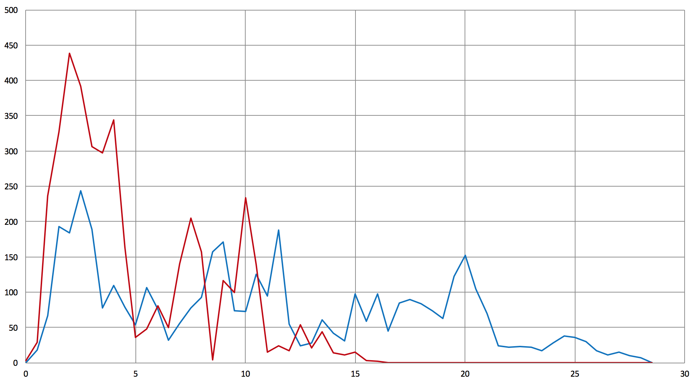
Link Prefetching
-- pre-fetch off
-- pre-fetch on
How does it look like?
# packets
Packets from www.wired.com
time (sec)

Slide 13
Research Questions
RQ1
Does prefetching itself provide an extra degree of defense?
RQ2
Can a victim confuse eavesdropper by simply turning off prefetching in their browser?
RQ3
Can prefetching be used as a browser-side defense mechanism?

Slide 14
Experiment
Experimental Setup
Configured two separate virtual machines to capture packets for 60 prefetching websites.
VM isolates experiment environment, removes most background noises.
By configuring two VMs and running them in parallel, we can minimize getting affected by the changes of websites over time.
Pre-fetch on
Pre-fetch off
VM1
60 websites
VM2

Slide 15
Experiment
Experimental Setup
Used a python script (implemented by Juarez M et al.*) to automatically execute Tor browser multiple times and capture incoming/outgoing packets for each sessions.
Captured each url for 15 times.
Capture for each connection finishes when the site is fully loaded or exceeds timeout (120s)
*Juarez, M. et al.: A Critical Evaluation of Website Fingerprinting Attacks. (2014).

Slide 16
Experiment
RQ1: Does prefetching itself provide an extra degree of defense?
Method
Train a classifier with the prefetching off dataset
Test the classifier with the prefetching on dataset

Slide 17
Experiment
RQ2: Can a victim confuse eavesdropper by simply turning off prefetching in their browser?
Use Case
Attacker trained their classifier assuming that user uses the default setting (pre-fetch on).
However, the victim turned off the pre-fetch setting on her/his browser.
The victim visits websites that uses prefetching.
Method
For a set of prefetching website, train the classifier where the prefetching was enabled.
Analyze victim traffic where prefetching is disabled.

Slide 18
Experiment
RQ3: Can prefetching be used as a browser-side defense mechanism?
Use Case
Prefetched links change randomly in a webpage
Attacker trains on subset of prefetched links
User visits webpage with different prefetched links
Method
For a set of prefetching website, train & test the classifier where we vary
number of prefetching requests
size of prefetched responses

Slide 19
Preliminary Results
Extracted 4 coarse features from 15 visits to 60 prefetching websites
# of incoming packets
Total size of incoming packets
# of outgoing packets
Total size of outgoing packets
Trained Naïve Bayes classifier on 80%, tested on 20% of extracted dataset
Prefetching-off accuracy = 38%
Prefetching-on accuracy = 33%

Slide 20
Ongoing work
Improve classifier accuracy by incorporating more recent work
Complete experiments for RQ1, RQ2, RQ3

Slide 21
Conclusion (so far)
Link prefetching
is currently deployed and used
seems to work as a defense mechanism
needs further evaluation for detailed recommendation

Slide 22
Related Works
Website fingerprinting attacks and defenses
Attacks
Herrmann et al. introduced the first WF attack on the Tor network with only a 3% success rate over 775 webpages
There are several extended works including Panchenko et al. , Cai et al. and Wang et al. to improve the accuracy rate by using more features and advanced classifiers
Defenses
BuFlo(Dyer et al.)
CSBuFlo(Cai et al.)
Tamaraw(Cai et al.)
Walkie-Talkie(Cai et al.)

Slide 23
Related Works (cont’)
Web Prefetching
Fan et al. introduced the first prefetching between caching proxies and clients to reduce the latency for users
Chen et al. pre-fetched web pages that will be visited near future
Nguyen et al. pre-fetched web components of web page, which users are visiting, to improve the performance of Tor

Slide 24
References
D. Herrmann, R. Wendolsky, and H. Federrath. Website Fingerprinting: Attacking Popular Privacy Enhancing Technologies with the Multinomial Näıve-Bayes Classifier. In ACM Workshop on Cloud Computing Security, pages 31–42. ACM, 2009
A. Panchenko, L. Niessen, A. Zinnen, and T. Engel. Website Fingerprinting in Onion Routing Based Anonymization Networks. In ACM Workshop on Privacy in the Electronic Society (WPES), pages 103–114. ACM, 2011.
T. Wang and I. Goldberg. Improved Website Fingerprinting on Tor. In ACM Workshop on Privacy in the Electronic Society (WPES), pages 201–212. ACM, 2013.
X. Cai, X. Zhang, B. Joshi, and R. Johnson. Touching from a Distance: Website Fingerprinting Attacks and Defenses. In ACM Conference on Computer and Communications Security (CCS), pages 605–616, 2012
M.Perry. A Critique of Website Traffic Fingerprinting Attacks. https://blog.torproject. org/blog/critique-website- traffic-fingerprinting-attacks, November 2013. Accessed Feb. 2014.
X. Luo, P. Zhou, E. W. Chan, W. Lee, R. K. Chang, and R. Perdisci. HTTPOS: Sealing Information Leaks with Browser-side Obfuscation of Encrypted Flows. In Proceedings of the 18th Network and Distributed Security Symposium, 2011.
C. Wright, S. Coull, and F. Monrose. Traffic Morphing: An Efficient Defense against Statistical Traffic Analysis. In Proceedings of the 16th Network and Distributed Security Symposium, pages 237–250, 2009.
K. Dyer, S. Coull, T. Ristenpart, and T. Shrimpton. Peek-a-Boo, I Still See You: Why Efficient Traffic Analysis Countermeasures Fail. In Proceedings of the 2012 IEEE Symposium on Security and Privacy, pages 332–346, 2012.
X. Chen and X. Zhang. A popularity-based prediction model for web prefetching. Computer, 36(3):63–70, Mar. 2003.
G. Nguyen, X. Gong, A. DAS, and N. Borisov. Poster – PnP: Improving Web Browsing Performance over Tor Using Web Resource Prefetch-and-Push. In ACM Conference on Computer and Communications Security (CCS), 2013
L. Fan and Q. Jacobson. Potential and limits of web prefetching between low-bandwidth clients and proxies, In Proceedings of the 1999 ACM SIGMETRICS international conference on Measurement and modeling of computer systems, pages 178-187, 1999

Slide 25
THANK YOU

